Slide 1

Quantitative Analyst Interview– Case Study
By Matthew Kim

Slide 2
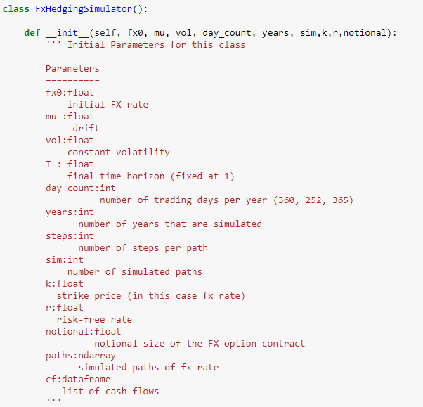
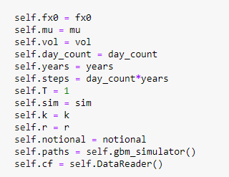

Slide 3

Geometric Brownian Motion
$$dF\left(t\right)=μF\left(t\right)dt+ σF\left(t\right)dW(t)$$
Ito’s Lemma
$$F\left(t\right)=F{\left(0\right)e}^{(μ − \frac{1}{2}σ^{2})t+ σW\left(t\right)}$$

Slide 4
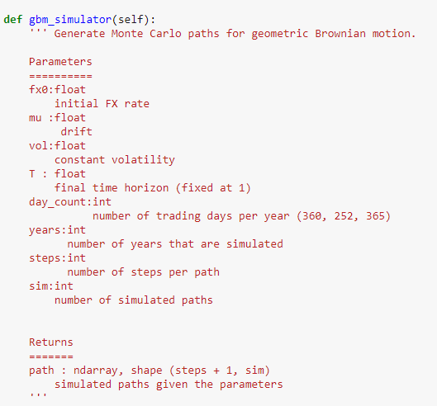

Slide 5
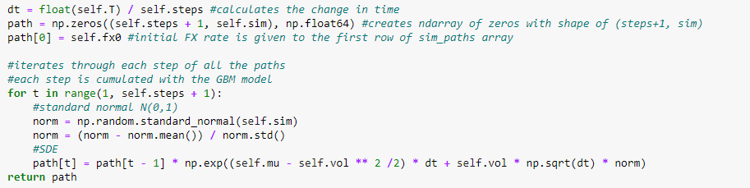
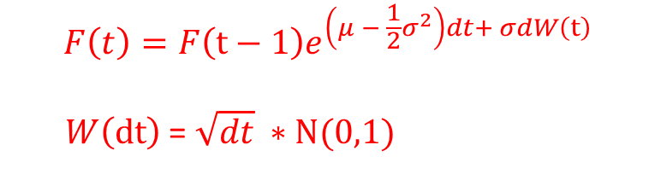
norm is random normal array with shape(1,sim).
$$F\left(t\right)=F{\left(t−1\right)e}^{\left(μ − \frac{1}{2}σ^{2}\right)dt+ σdW\left(t\right)}$$
$W\left(dt\right)$ = $\sqrt{dt} ∗N(0,1)$

Slide 6
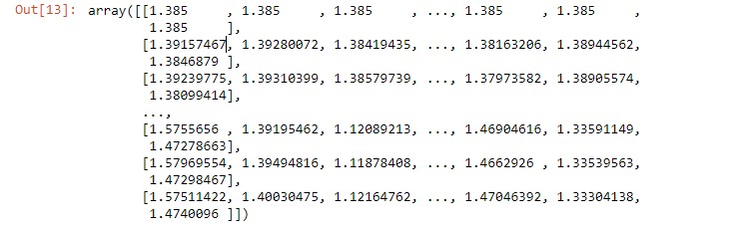
path =

Slide 7
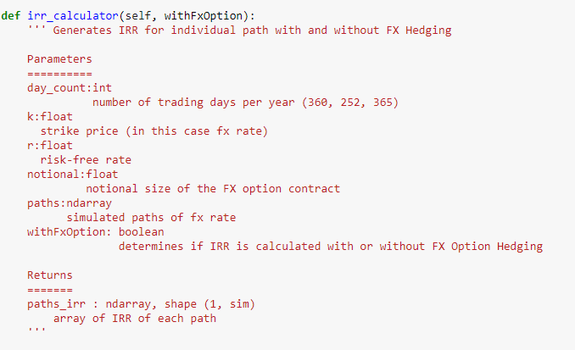

Slide 8
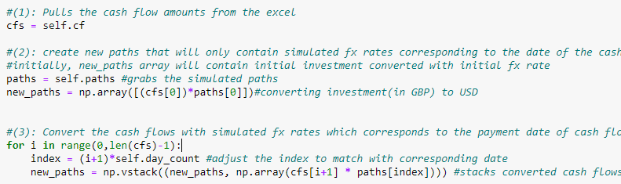
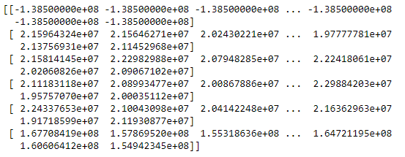
self.cf = self.DataReader()
self.paths = self.gbm_simulator()
new_paths =

Slide 9
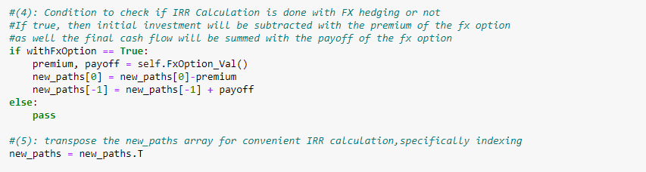
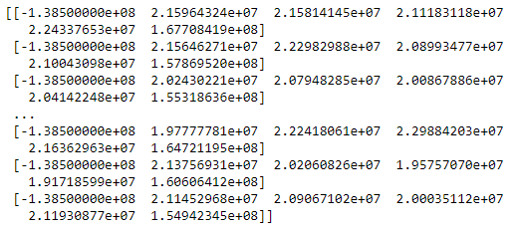
new_paths =

Slide 10
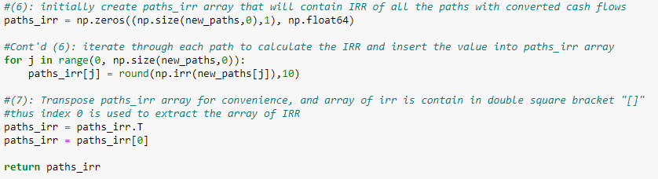
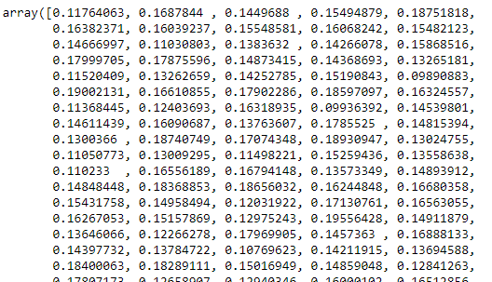

Slide 11


FX Option Valuation

Slide 12
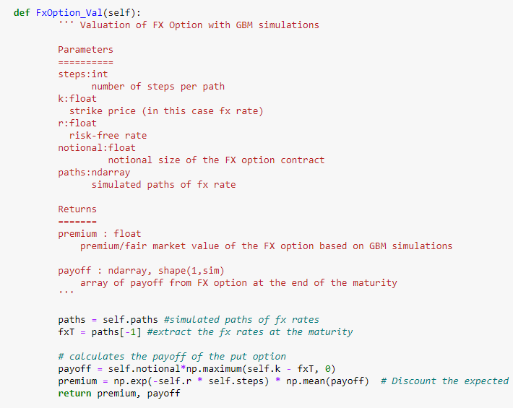

Slide 13
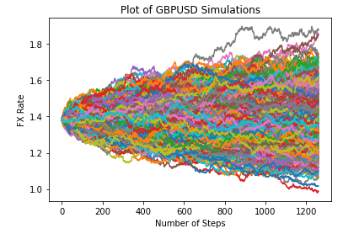
Result

Slide 14
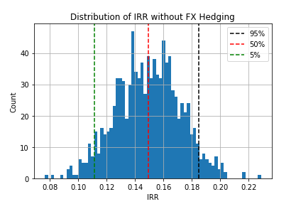
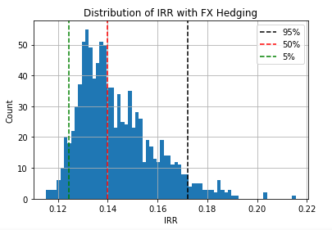
Floor effect
Less IRR for 50% and 95% Percentiles
Guarantee to make at least 10%
Higher IRR for 50% and 95% percentiles
But strong likelihood of making less than 10% IRR

Slide 15
Thank you for listening ☺

